Slide 1
Refactoring Queries for Improved Performance

Slide 2


3 Techniques for Performance Tuning
Server/Database Settings
Index Modifications
Query Refactoring
Notes:
Server/Database Settings – things that will improve performance of all queries running on your instance
MAXDOP, Cost Threshold for Parallelism, Adhoc Workloads, Auto update statistics, right number of tempdb files, etc…
Index Modifications
Can improve performance of many queries running on one table at a time.
Easy clean up of unused indexes, combining and deleting duplicate indexes, and creating new indexes.
End of the day, Indexes dictate how data comes from disk, both in sort order and size in columns and rows. Ultimately this is the biggest factor for index performance in my mind.
Query Refactoring
This is rewriting the query itself. Getting rid of unnecessary joins, cleaning up select *s that aren’t needed
This is very highly targeted because you can only focus on one query at a time. It’s like killing weeds in your lawn – the other options are like laying down some chemical to kill weeds everywhere, while query refactoring is going in with a trowel and digging them up one by one.
By the way, is anyone ever jealous of like sound engineers and stuff who get to play with physical knobs to tweak settings? Imagine live query tuning, move a knob to push something to go parallel or twist a knob to change join types.

Slide 3



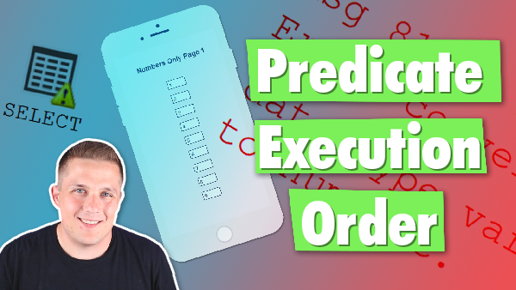


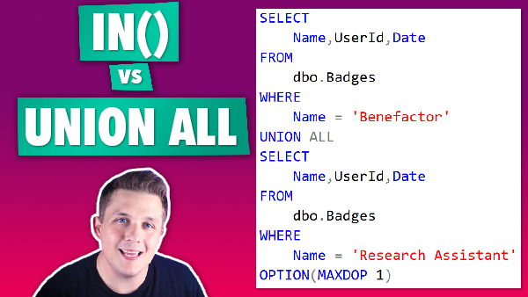
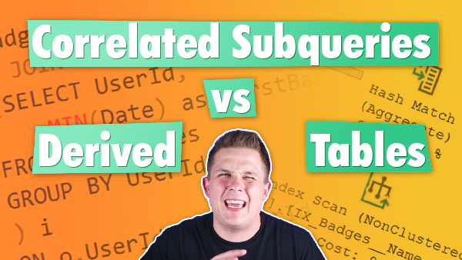
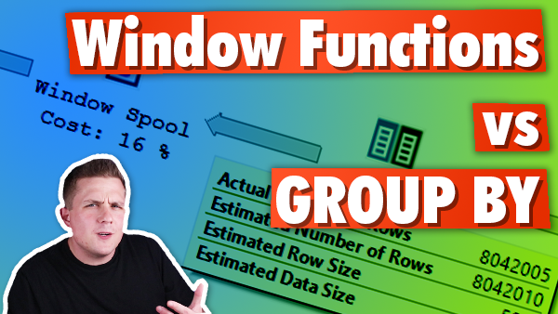
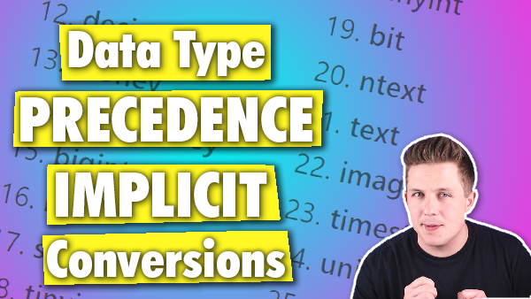
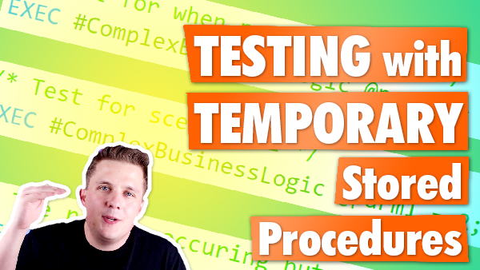




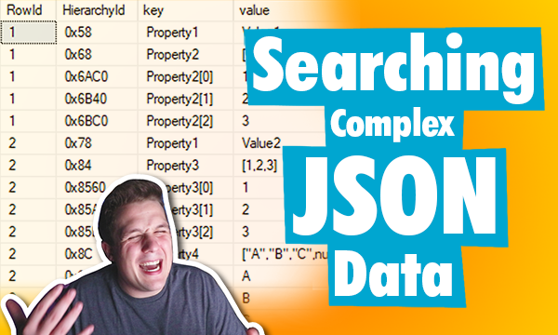
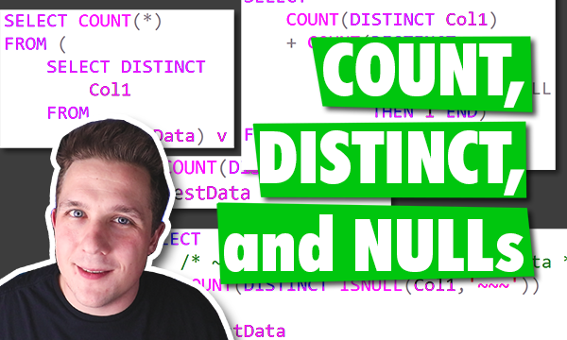

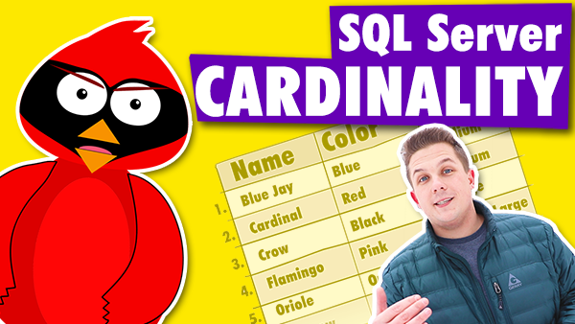

Bert Wagner
Notes:
Background to maybe help explain more of my motivations for this presentation.
Developer
YouTuber
I created this presentation because going back to when I started working with SQL Server, I often wrote inefficient queries. Over the years, I’d learn trick at one user group meeting, and another technique at a conference, and over the years I’ve collected a lot of these tips – but I’ve never seen a source that had a collection of all of these tips and tricks

Slide 4

You Can’t Always Get What You Want
Vendor databases
“Fragile” systems
Not enough disk space
Old hardware
Limited tooling/ad hoc analysis
Features limited by security software
Notes:
Sometimes you can’t use all of these great features of SQL Server though!
Vendor database. Can’t change objects. Can’t change SQL Server version. Can’t change settings.
“Fragile” or heavily utilized system. Too many indexes already. Too many users doing too many different things. Would require months of testing.
Not enough disk space. If capacity planning screwed up, might take a while before you can get a new SAN unit.
Or maybe have SAN, but lots of red tape to get that additional disk space RIGHT NOW.
Old hardware. Can’t get new hardware. So can’t increase CPUs for MAXDOP. All settings already maxed out.
Limited tooling/ad hoc analysis – end users, like analysts, using python, r, etc… may need to run things only once or for a short project. Might not be worth effort to add indexes.
Security software limits – may have newer versions of SQL Server, but can’t use all features because of security software limiting to a version

Slide 5
Agenda
Why the Optimizer Gets It Wrong
Query Hints and Trace Flags – Bleh
Coercing the Optimizer Demos
Notes:
Background to maybe help explain more of my motivations for this presentation.
Developer
YouTuber
I created this presentation because going back to when I started working with SQL Server, I often wrote inefficient queries. Over the years, I’d learn trick at one user group meeting, and another technique at a conference, and over the years I’ve collected a lot of these tips – but I’ve never seen a source that had a collection of all of these tips and tricks

Slide 6
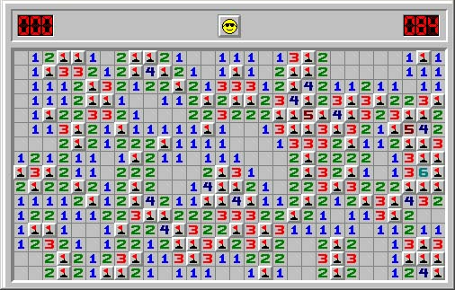
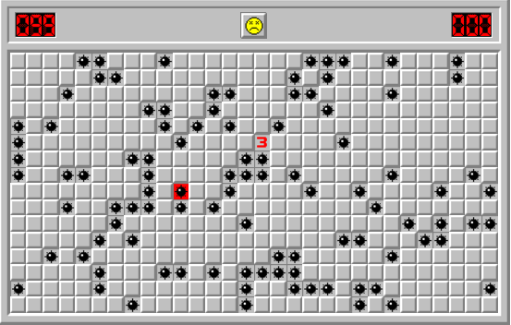
Hints and Trace Flags
Notes:
Trace flags and query hints are great for debugging code. They help identify issues quicker by being able to change SQL Server’s behavior fix certain issues.
I use them a lot when I have a production issue and need an immediate stop gap
I don’t like putting them into production permanently.
Some trace flags are the exception, because some fix documented issues and are generally deemed as safe
Query hints however, especially ones like join hints, index hints, and the like can make things go terribly wrong
Like when the hinted object changes/is deleted, the query fails completely instead of falling back
So while trace flags and query hints are options for refactoring poorly performing queries, they aren’t the focus of today’s presentation.
Used to solve very specific problems. It is rare that I ever use these in production code.
Problematic because can break other queries
Problematic because can break over time
Problematic because not fixing a root cause that may be affecting other queries
If you ever use them, document them extremely well so somenoe doesn't go chasing down the rabbit hole based on assumptions that are wrong because some hitn or flag is there.
Good for specific bugs/scenarios. General performance tuning – NO!!

Slide 7
Optimizer Woes
SQL is a declarative language
The optimizer works on assumptions and data
If either of those are inadequate, it will generate poor performing plans
Always best to solve the root cause…but sometimes you can’t
Some queries are just too complicated
Notes:
Declarative not imperative/procedural
How the optimizer works
Why it generates inefficient plans sometimes
Bad distribution statistics – bad estimates of density of what data looks like (more selective = lower density)
Parallel plans are expensive to calculate, might not have time to go through options
Why simple query rewrites don’t work – cost based optimizer decides how to get data on its own.
Why do isn't SQL Server smart enough to figure this out?
SQL server already does rewrites in the Simplication Phase, tries different plans in Exploration, (great post by Paul White on optimizer internals https://sqlkiwi.blogspot.com/2012/04/query-optimizer-deep-dive-part-1.html), but sometimes SQL Server gets it wrong. It's always best to solve the root cause of SQL Server getting it wrong, which is usually through things like improved indexes, better statistics, etc... but sometimes you can't do that.
SQL Server also budgets a limited amount of time to try to find a plan. It picks a good enough plan, not best plan. While it’s not possible, if we were to allow SQL SERVER to search for plans for an hour like we are about to do now, There’s a good chance it would find these same (or better) plans.
In particular a lot of problems come from Cardinality estimation. SQL Server only knows the number of rows in a table and the 200 step histogram from stats about each table. SQL Server then uses a lot of assumptions about the relationships between columns, the distribution of your data, etc... to estimate row sizes and counts. If this data is missing or not maintained, you have problems. If you have complex queries that do lots of transformations, SQL server is having to calculate estimates of estimates of estimates ….which can be totally off and cause problems.
Also makes assumptions on sq servers costing mode. Like assumes you are using spinning disks. Anyone not using SSDs at this point? SQL server searches for a good enough plan based on its own assumptions. So sometimes it’s assumptions will not generate the best plan for your scenario because they are wrong.
The Optimizer is Not Infallible! This is why we perform query rewrites.
Quote from Paul White part 4 “The skilled query tuner will often be able to do better than the optimizer, given enough time and perhaps a better insight to the data”

Slide 8
Demos
Window Functions vs. GROUP BY
Correlated Subqueries vs Derived Tables
IN vs UNION ALL
Temporary Staging Tables
Forcing JOIN Orders
Finding DISTINCT Values
Notes:
- Preran demos so we wouldn’t waste time watching the loading icon spin
- You might notice I’m using MAXDOP 1 everywhere. This is not a recommendation!
- Using MAXDOP 1 for consistency between queries. Also I did not run these queries on large servers with may cores so I really wanted to limit to single thread plans.
- Funny story – I’ve wanted to do this presentation for a *long* time, but knew I’d need demos. Didn’t realize how hard it would be to create them for these! I always see them happen in the wild,

Slide 9
And that’s not all!
Convert UDFs to Inline logic
Putting code in scalar functions to make it run serially
DISTINCT vs GROUP BY
NOT IN vs NOT EXISTS
Index Compression
Materialized Views
Change cardinality estimator
Copy the data somewhere that you can index
… and more

Slide 10





Thank you!
@bertwagner
bertwagner.com
youtube.com/bertwagner
bert@bertwagner.com
New posts and videos every Tuesday!

